Slide 1
Welman Therapeutic Center
For Internet Addiction
Nicolas
Jeremy
Hovannes

Slide 2
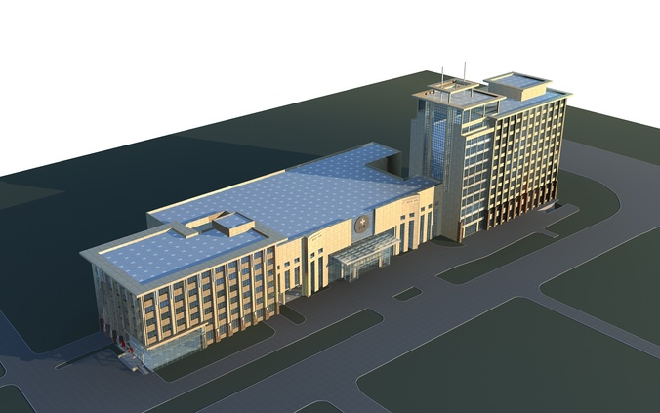
Therapeutic center for youth facing Internet addiction

Slide 3


The virtues of seclusion

Slide 4
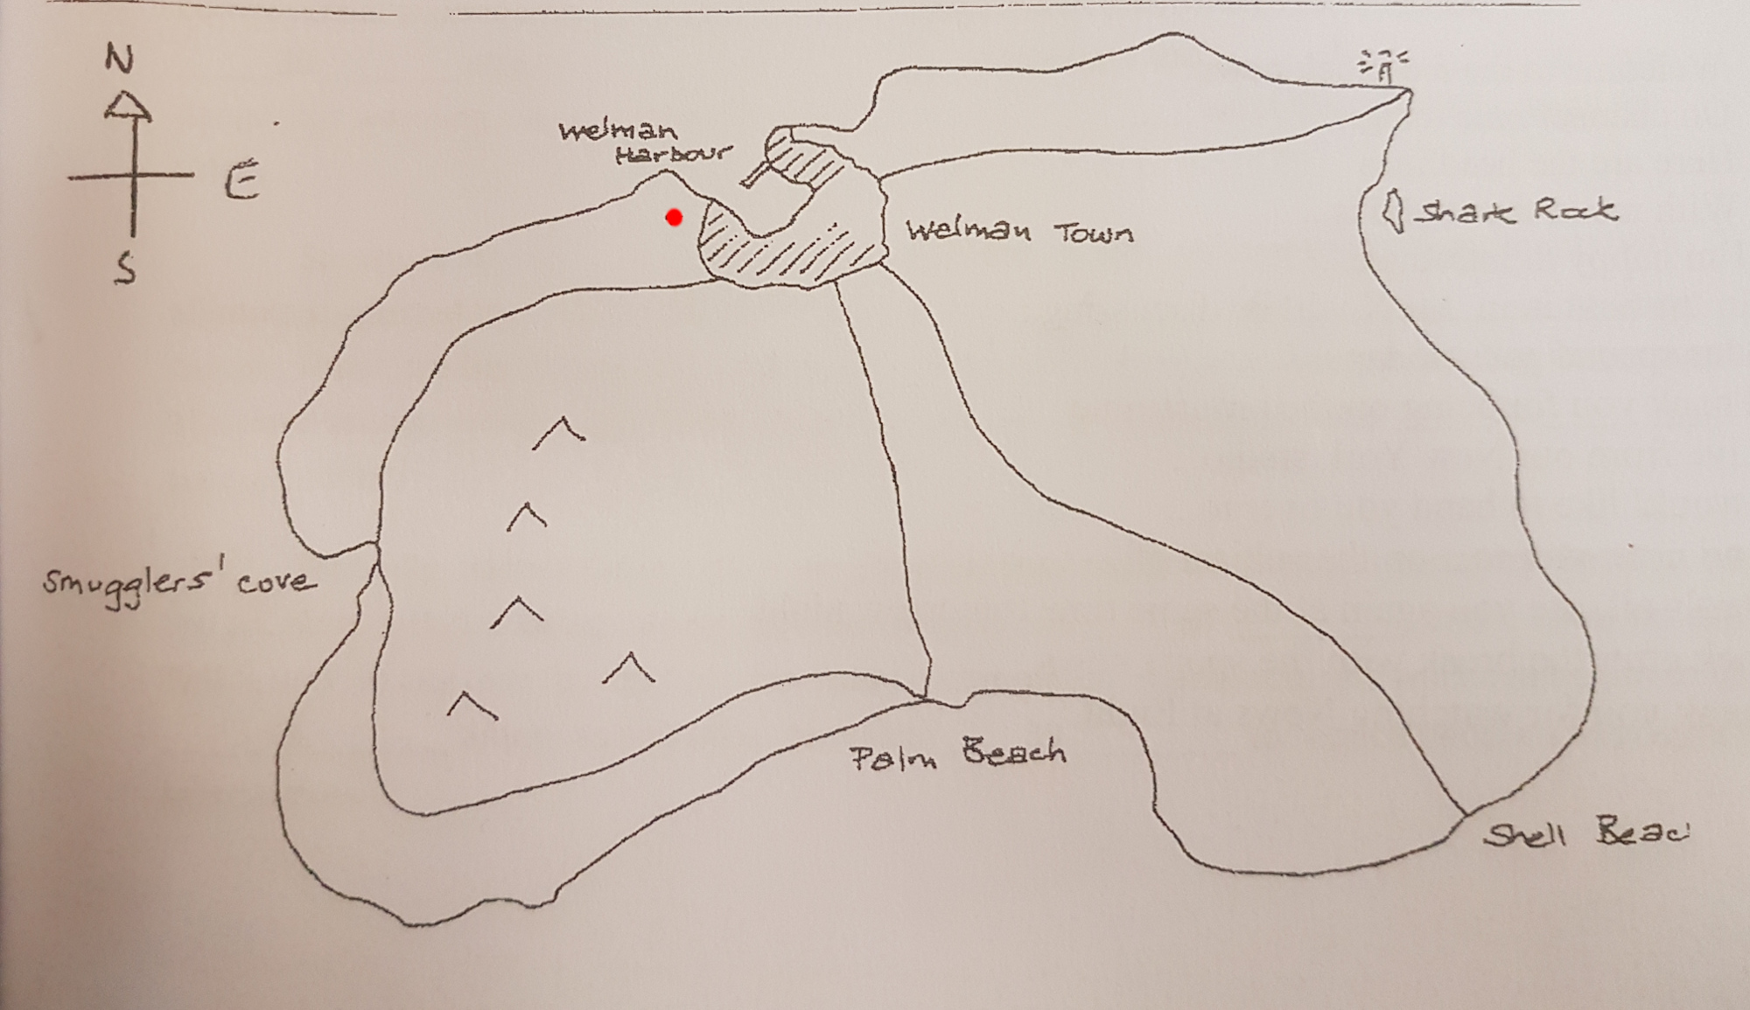
Where?
Close to the wilderness : field trips, sensibilization…
Close to the town : supply access, turnover...

Slide 5

What’s in it for Welman?
Bringing in workers with all sorts of skills
More people = more need to trade and communicate with the mainland
More people and more trade = push to the local economy
Being at the core of a fresh start for troubled youth

Slide 6

Addiction
Disorder of :
Personality
Behavior
Causes :
Excessive attachment
Health problems

Slide 7
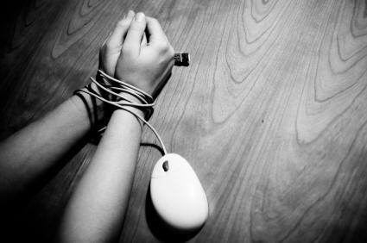
Internet addiction
It includes a dependence of :
Games
Social media’s
Online shopping
Pornography
etc.
--> Excessive and obsessional need to use a computer.

Slide 8
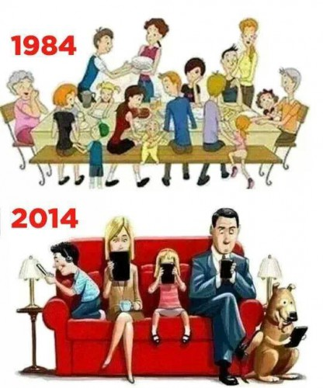
Important
Public health problem
Affects the entire population
Needs fast treatment.
Consult doctors, psychologists
Treatment

Slide 9
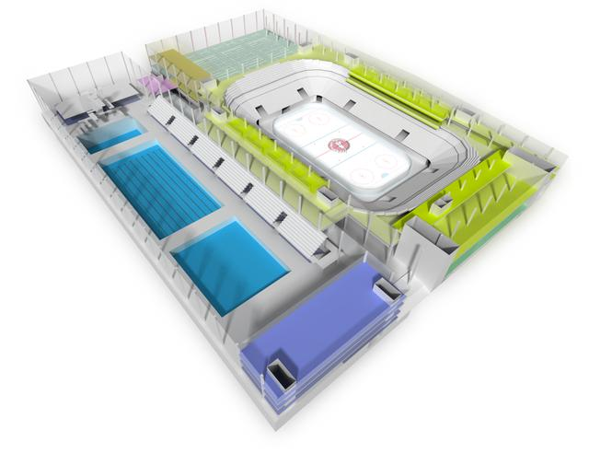
Composition
Big living place
Own rooms
Sauna
Sport center
Doctors, Psychologists
Trainers
Teachers

Slide 10

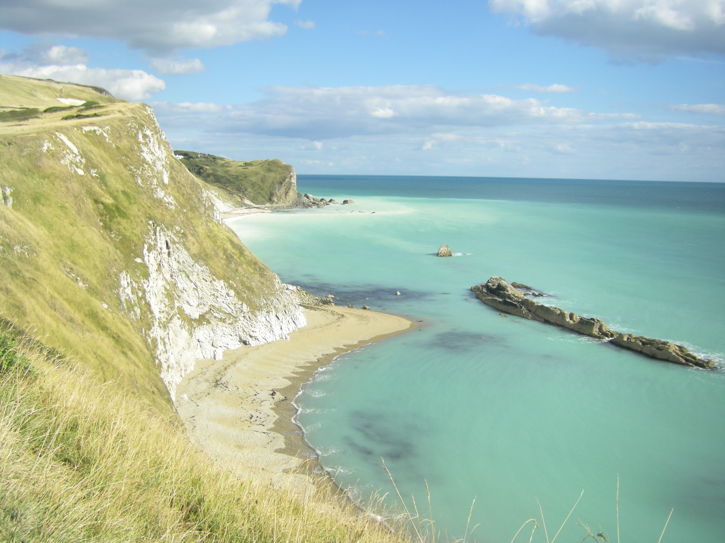
Isolated Island
Natural parks
Beach
Beautiful places
--> Healthy environment

Slide 11
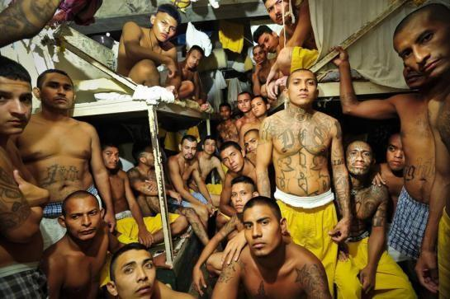
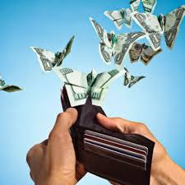
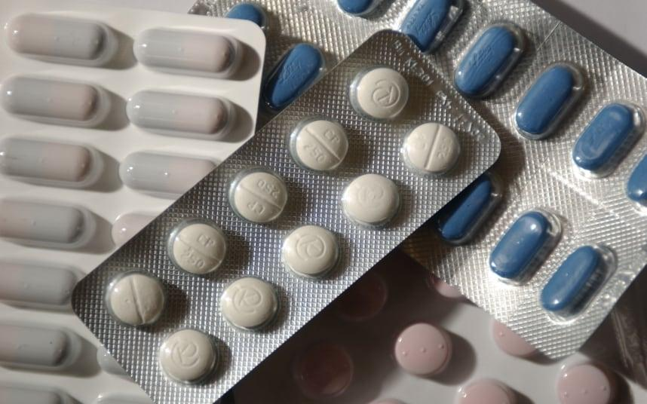
A lot of demands
Centers on the continent are overcrowded
Parents spend a lot of money
Patients don’t want chill pills anymore

